Slide 1
Support Vector Machines
Tim Pengajaran
Mata Kuliah Machine Learning
Jurusan Teknologi Informasi Tahun 2021

Slide 2
Disclaimer
This presentation material, including examples, images, references are provided for informational and explanation assistance only
The names of actual products and companies mentioned here in, if any, may be the trademarks of their respective owners
Credits shall be given to the images taken from the open-source and cannot be used for promotional activities

Slide 3
Outline
What is Support Vector Machines?
Kernels and the Kernel Trick
Maximum Margin Classification and Support Vectors
Classifying Characters in scikit-learn
Handwritten digits
Characters in natural images

Slide 4
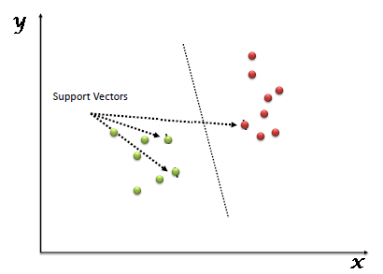
What is Support Vector Machines?
A supervised machine learning algorithm.
Can be used for both classification or regression, but it is mostly used for classification.
Attempts to find the line that "best" separates two classes of points.
"best“ means the line that results in the largest margin between the two classes.

Slide 5
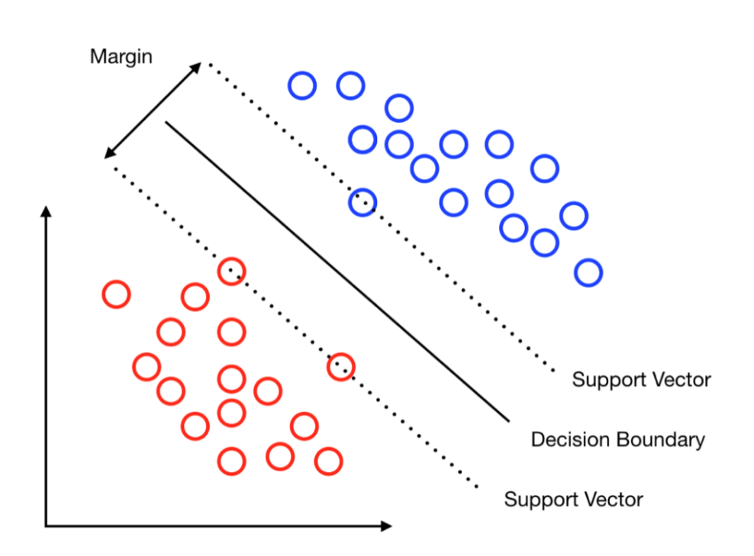
What is Support Vector Machines?
In the SVM algorithm, plot each data item as a point in n-dimensional space (where n is number of features you have) with the value of each feature being the value of a particular coordinate.
Perform classification by finding the hyper-plane that differentiates the two classes very well.

Slide 6
Why is SVM?
Modeling a linear relationship between the response variable and the features in the higher dimensional feature space has two problems:
Computational problem, i.e. computing the mapped features and working with larger vectors requires more computing power.
Generalization, i.e. increasing the dimensions of the feature representation exacerbates the curse of dimensionality, because learning from high-dimensional feature representations requires exponentially more training data to avoid overfitting.

Slide 7
Hyperplanes
Can be considered decision boundaries that classify data points into their respective classes in a multi-dimensional space.
Data points falling on either side of the hyperplane can be attributed to different classes.
A generalization of a plane:
in two dimensions, it’s a line.
in three dimensions, it’s a plane.
in more dimensions, you can call it a hyperplane.

Slide 8
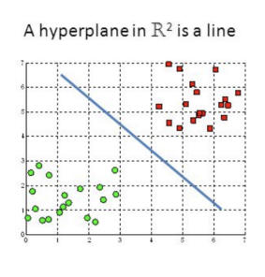
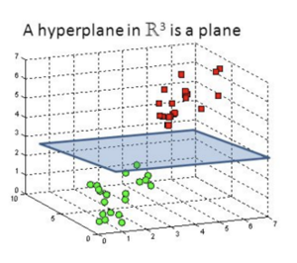
Hyperplanes

Slide 9
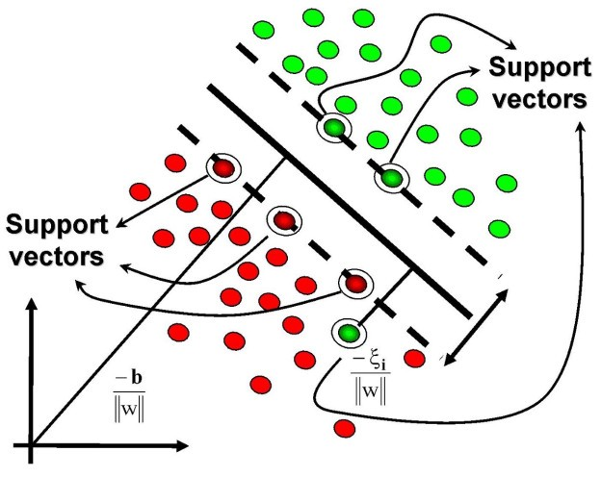
Support Vectors
The points that lie on or fall within the margin.
Used to formulate to find the "margin hyperplane“, the line that best separates the two classes.
So-called as dual form.
Can be used to apply the kernel trick to effectively transform the SVM into a non-linear classifier.

Slide 10
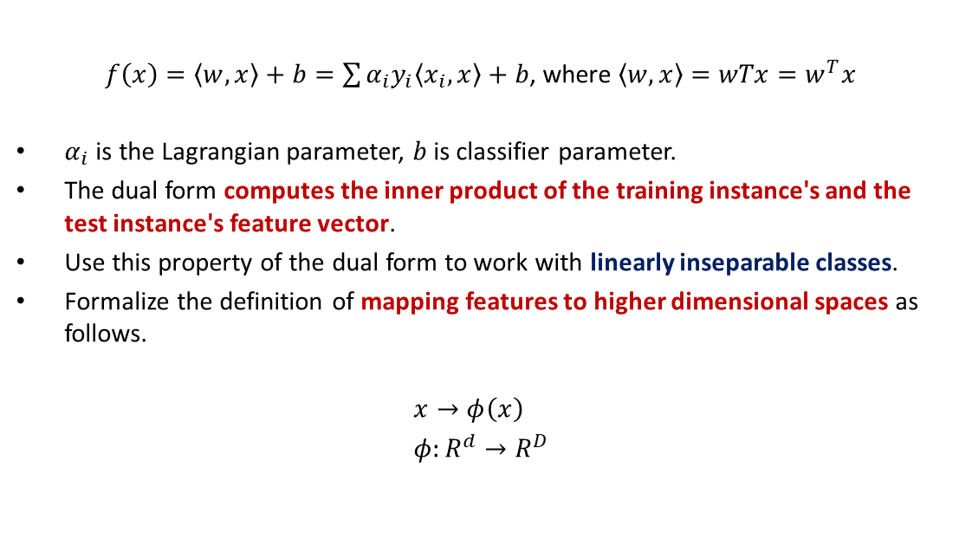
Mathematics of Dual Form
$f\left(x\right)=\left\langle w,x\right\rangle +b=\sum{α_{i}y_{i}\left\langle x_{i},x\right\rangle +b}$, where $\left\langle w,x\right\rangle =wTx=w^{T}x$
$α_{i}$ is the Lagrangian parameter, $b$is classifier parameter.
The dual form computes the inner product of the training instance's and the test instance's feature vector.
Use this property of the dual form to work with linearly inseparable classes.
Formalize the definition of mapping features to higher dimensional spaces as follows.
$$x→φ\left(x\right) \\ φ:R^{d}→R^{D}$$

Slide 11
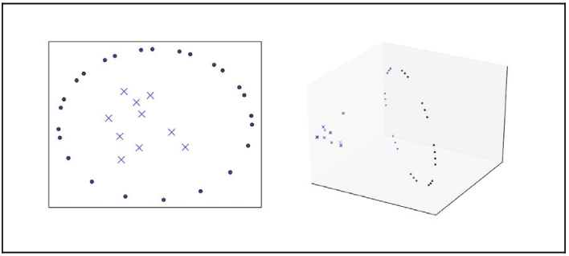
Mapping to Higher Dimensional Space
Linearly inseparable dataset in lower dimensional space
Linearly separable dataset in higher dimensional space

Slide 12
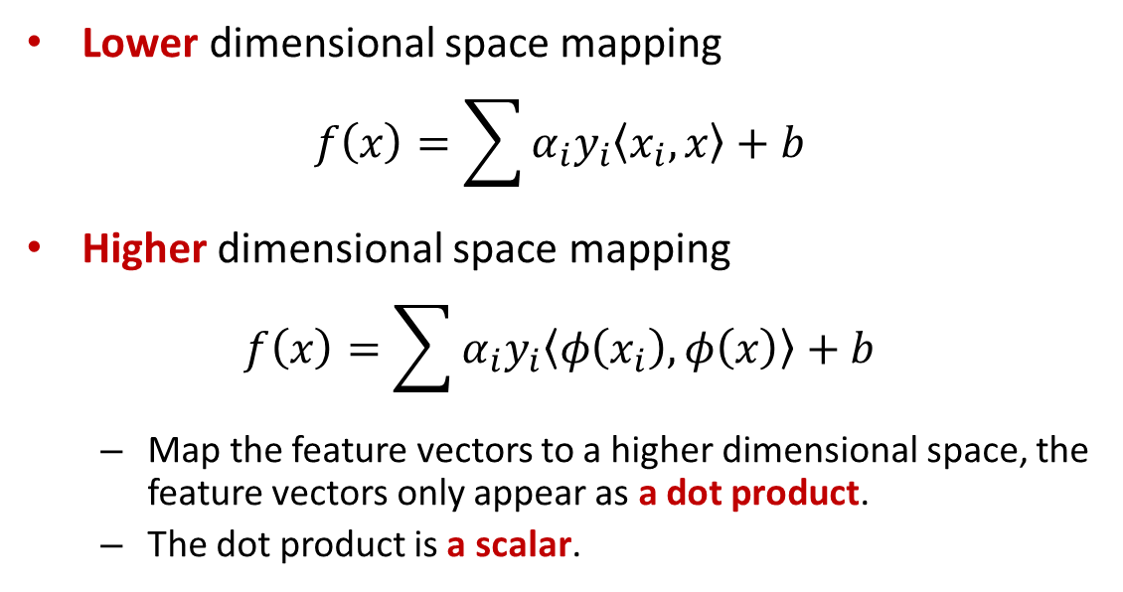
Mapping to Higher Dimensional Space
Lower dimensional space mapping
$$f\left(x\right)=\sum{α_{i}y_{i}\left\langle x_{i},x\right\rangle +b}$$
Higher dimensional space mapping
$$f\left(x\right)=\sum{α_{i}y_{i}\left\langle φ\left(x_{i}\right),φ\left(x\right)\right\rangle +b}$$
Map the feature vectors to a higher dimensional space, the feature vectors only appear as a dot product.
The dot product is a scalar.

Slide 13
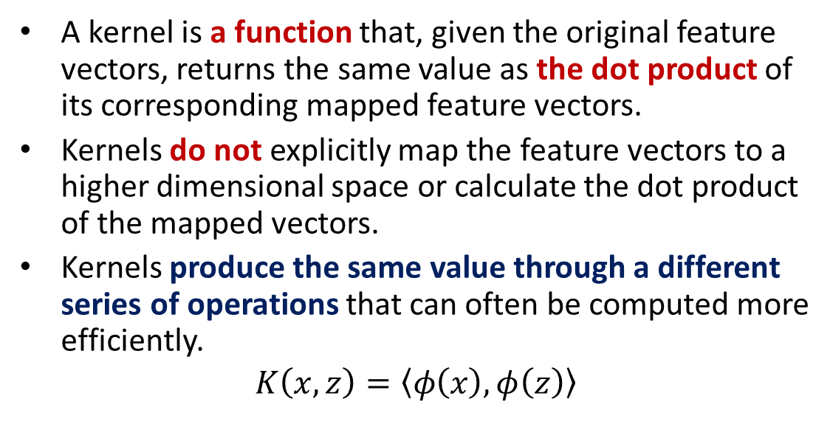
Kernel Tricks
A kernel is a function that, given the original feature vectors, returns the same value as the dot product of its corresponding mapped feature vectors.
Kernels do not explicitly map the feature vectors to a higher dimensional space or calculate the dot product of the mapped vectors.
Kernels produce the same value through a different series of operations that can often be computed more efficiently.
$$K\left(x,z\right)=\left\langle φ\left(x\right),φ\left(z\right)\right\rangle$$

Slide 14
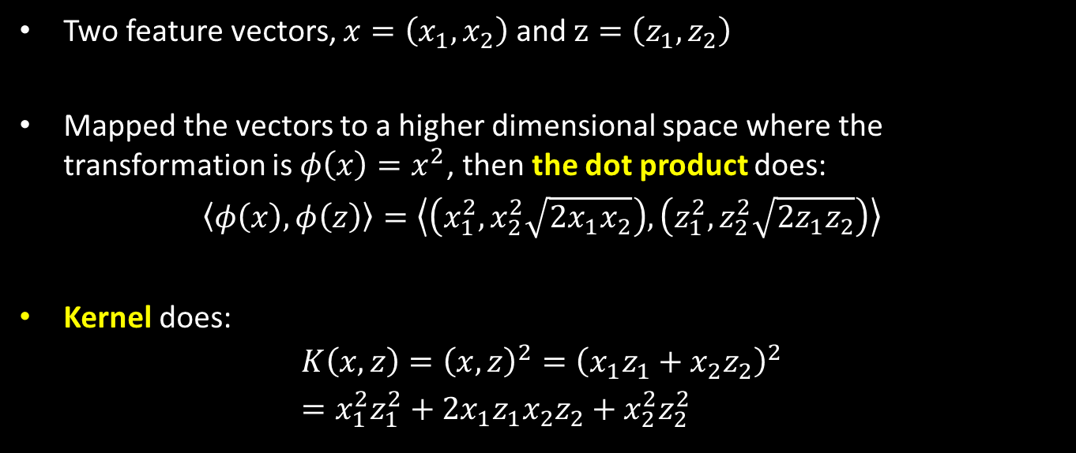
Kernel Computation
Two feature vectors, $x=\left(x_{1},x_{2}\right)$ and $z=\left(z_{1},z_{2}\right)$
Mapped the vectors to a higher dimensional space where the transformation is $φ\left(x\right)=x^{2}$, then the dot product does:
$$\left\langle φ\left(x\right),φ\left(z\right)\right\rangle =\left\langle \left(x_{1}^{2},x_{2}^{2}\sqrt{2x_{1}x_{2}}\right),\left(z_{1}^{2},z_{2}^{2}\sqrt{2z_{1}z_{2}}\right)\right\rangle$$
Kernel does:
$$K\left(x,z\right)={\left(x,z\right)}^{2}={\left(x_{1}z_{1}+x_{2}z_{2}\right)}^{2} \\ =x_{1}^{2}z_{1}^{2}+2x_{1}z_{1}x_{2}z_{2}+x_{2}^{2}z_{2}^{2}$$

Slide 15
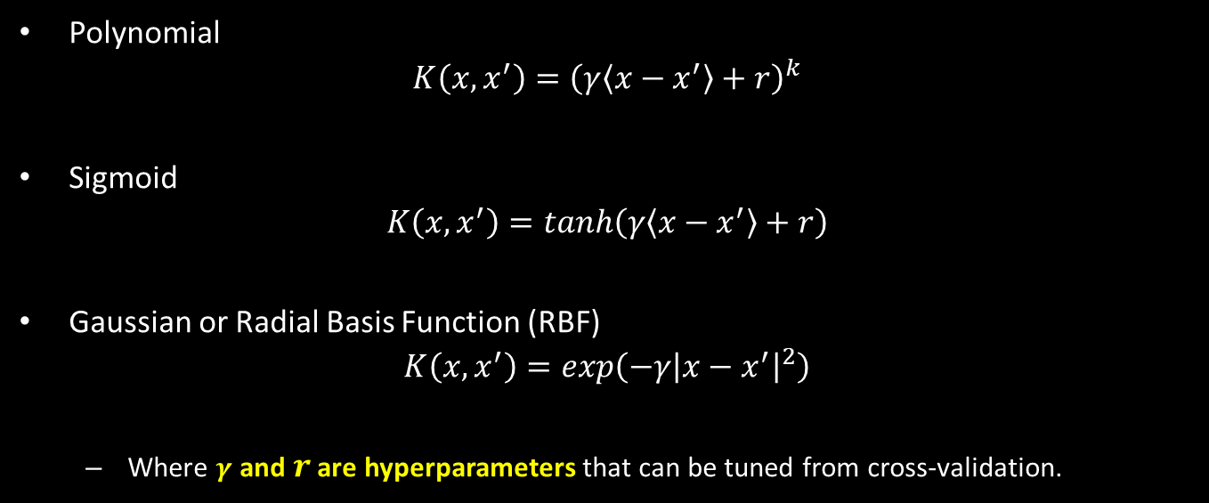
Types of Kernel
Polynomial
$$K\left(x,x^{′}\right)={\left(γ\left\langle x−x^{′}\right\rangle +r\right)}^{k}$$
Sigmoid
$$K\left(x,x^{′}\right)=tanh\left(γ\left\langle x−x^{′}\right\rangle +r\right)$$
Gaussian or Radial Basis Function (RBF)
$$K\left(x,x^{′}\right)=exp\left(−γ{\left|x−x^{′}\right|}^{2}\right)$$
Where $γ$ and $r$ are hyperparameters that can be tuned from cross-validation.

Slide 16
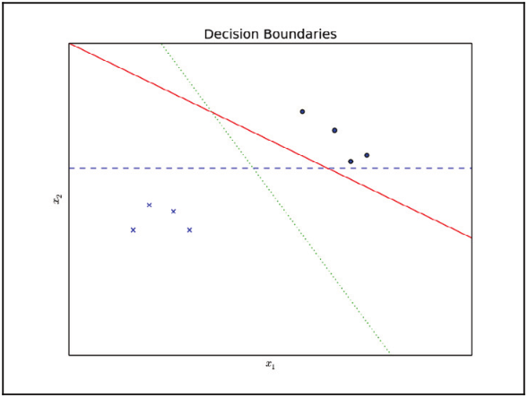
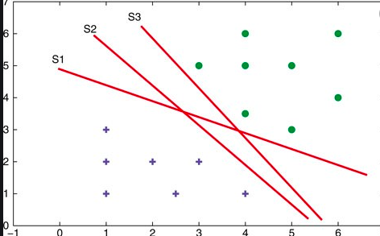
Maximum Margin Classification and Support Vectors

Slide 17
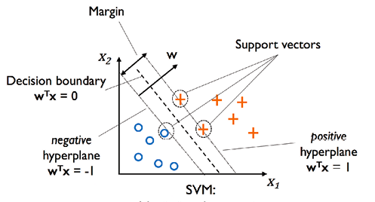
Which Hyperplane to Pick?

Slide 18
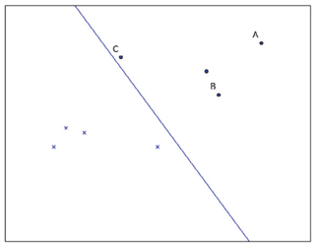
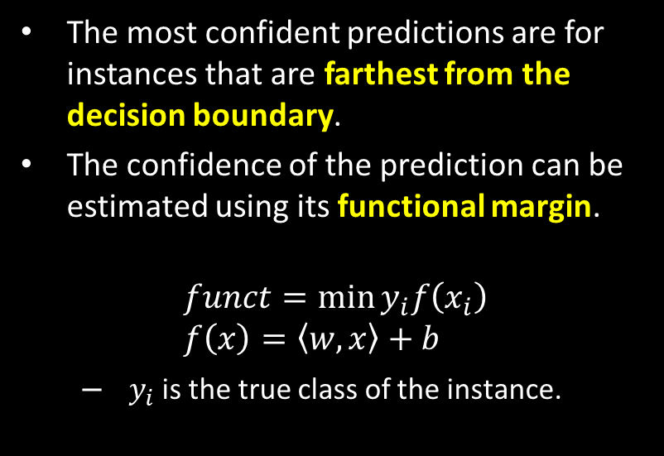
Find the Best Hyperplane
The most confident predictions are for instances that are farthest from the decision boundary.
The confidence of the prediction can be estimated using its functional margin.
$$funct=\min{y_{i}f\left(x_{i}\right)} \\ f\left(x\right)=\left\langle w,x\right\rangle +b$$
$y_{i}$is the true class of the instance.

Slide 19
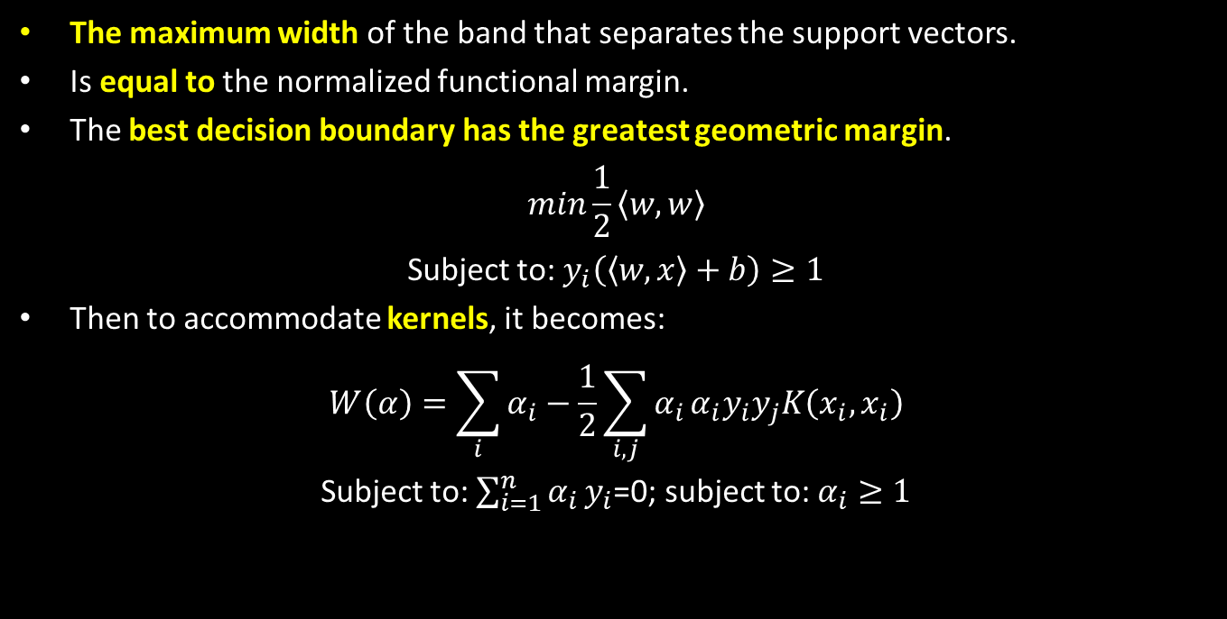
Geometric Margin
The maximum width of the band that separates the support vectors.
Is equal to the normalized functional margin.
The best decision boundary has the greatest geometric margin.
$$min\frac{1}{2}\left\langle w,w\right\rangle$$
Subject to: $y_{i}\left(\left\langle w,x\right\rangle +b\right)≥1$
Then to accommodate kernels, it becomes:
$$W\left(α\right)=\sum_{i}{α_{i}−\frac{1}{2}\sum_{i,j}{α_{i}}{α_{i}y_{i}y}_{j}K\left(x_{i},x_{i}\right)}$$
Subject to: $\sum_{i=1}^{n}{α_{i}}y_{i}$=0; subject to: $α_{i}≥1$

Slide 20
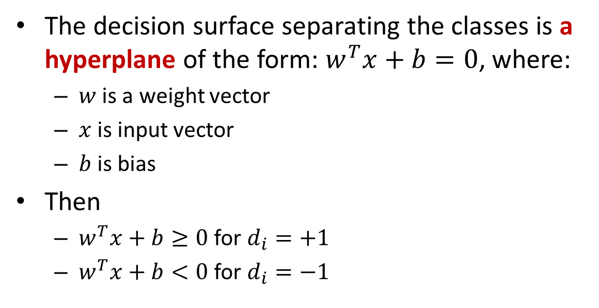
Defining the Separating Hyperplane
The decision surface separating the classes is a hyperplane of the form: $w^{T}x+b=0$, where:
$w$ is a weight vector
$x$ is input vector
$b$ is bias
Then
$w^{T}x+b≥0$for $d_{i}=+1$
$w^{T}x+b<0$for $d_{i}=−1$

Slide 21
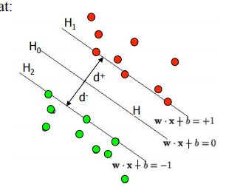
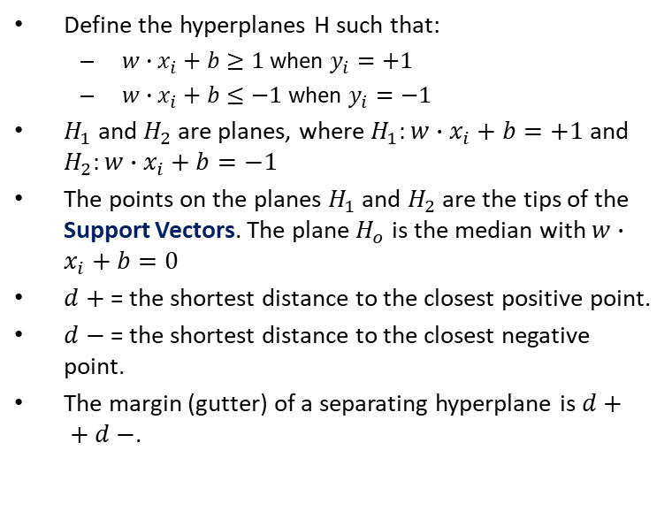
Hyperplane as Means for Classification
Define the hyperplanes H such that:
$w∙x_{i}+b≥1$ when $y_{i}=+1$
$w∙x_{i}+b≤−1$ when $y_{i}=−1$
$H_{1}$ and $H_{2}$ are planes, where $H_{1}:w∙x_{i}+b=+1$ and $H_{2}:w∙x_{i}+b=−1$
The points on the planes $H_{1}$ and $H_{2}$ are the tips of the Support Vectors. The plane $H_{o}$ is the median with $w∙x_{i}+b=0$
$d+$ = the shortest distance to the closest positive point.
$d−$ = the shortest distance to the closest negative point.
The margin (gutter) of a separating hyperplane is $d+ + d−$.

Slide 22
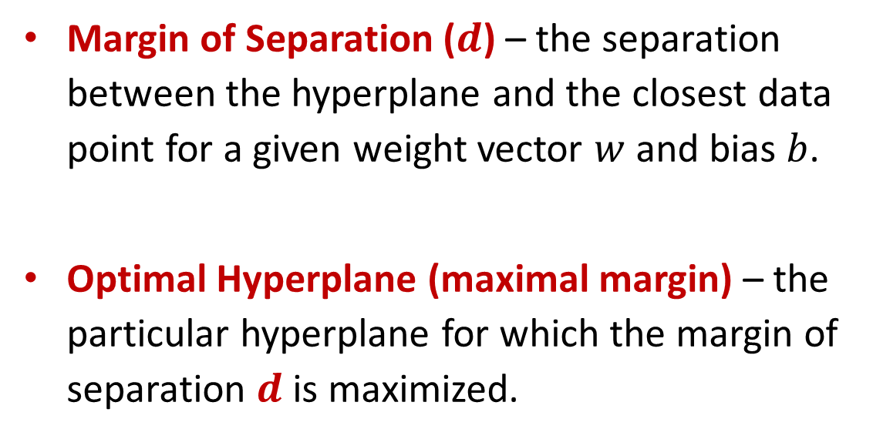
Definitions
Margin of Separation ($d$) – the separation between the hyperplane and the closest data point for a given weight vector $w$ and bias $b$.
Optimal Hyperplane (maximal margin) – the particular hyperplane for which the margin of separation $d$ is maximized.

Slide 23

Let’s See Some Videos

Slide 24
Classifying Characters in scikit-learn
Handwritten digits
Characters in natural images
Do yourself for home practice.

Slide 25
Thank You for Today
Always Keep Your Spirit!

